Slide 1
Architecture Slides Template
Your starting point for great architecture presentations
Bernhard Walter Last updated 2025-02-04

Slide 2
Lakehouse Architecture Positioning

Slide 3
Modern Data Platform - Framework
Data Engineer
ML Engineer
Data Scientist
Business Analyst
App Developer
Business Partner
ETL & DS tools
BI Tools
Data and AI Apps
Collaboration
Orchestration
Ingest & Transform
Advanced Analytics, ML & AI
Data Warehouse
Operational Database
AI Engine
Data & AI Governance
Cloud Storage
Notes:
tag:overview,L100-200
This is a simple framework for a modern data platform
It shows on top the 5 main persona using the platform:
Data engineer
ML engineer
Data scientist
Business analyst
Business partner
And it comes with 4 layers:
The “Storage” layer: All data files are stored in the Cloud Object Storage
The “Data Governance” layer contains capabilities around access control, metadata management, lineage tracking, …
The “Engine” layers, actually comprises of 3 sub layers:
The bottom layer is the AI engine layer. In this layer AI and Gen AI models will be provided that support all other functions in the platform
The value generation layer. It consist of the domains for the 3 main workload types:
Data ingest and transformations for all tasks to get data into the platform
The “Advanced Analytics, ML & AI” engine for ML, Ai and Gen AI use cases
The “Data Warehouse” engine for data warehouse and BI use cases
The orchestration layer that provides all capabilities around workflow management
The “Consumption” layer containing the front-ends and tools for all workloads

Slide 4
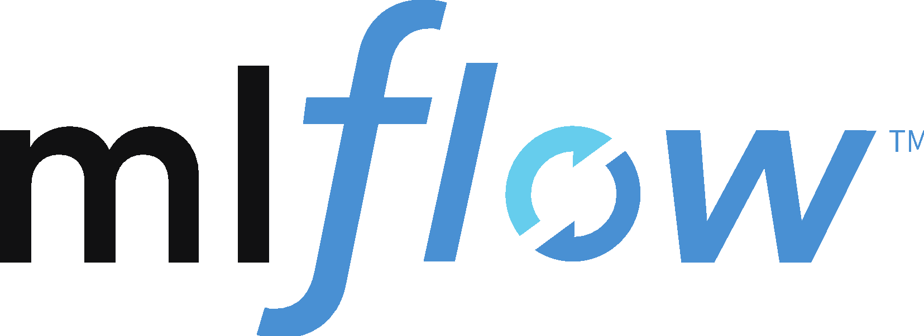

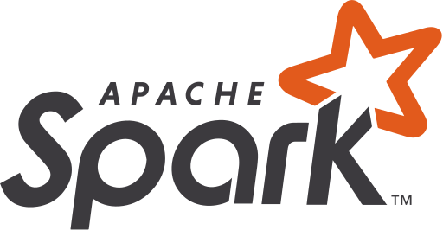






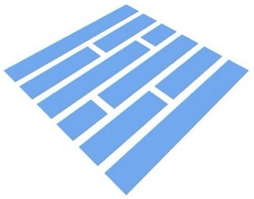

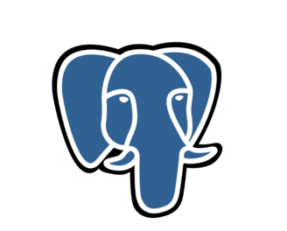
Databricks “Data Intelligence Platform”
Data Engineer
ML Engineer
Data Scientist
Business Analyst
App Developer
Business Partner
Dev tools
BI
Apps
Collaboration
IDE support
Notebooks
AI/BI Genie
AI/BI Dashboard
SQL Editor
Databricks Apps
Automation
Lakeflow Jobs
CI/CD
MLOps
Delta Sharing
Ingest & Transform
Advanced Analytics, ML & AI
Data Warehouse
Operational Database
Marketplace
Batch & Streaming
Data Quality
ML
Modeling
Gen AI
AI Functions
Databricks SQL
Lakebase
Clean Rooms
Lakeflow Connect
Lakeflow Decla- rative Pipelines
Real time Analytics
Model Serving
Photon
AI Engine
Data Intelligence
Search & Discover
Assistant
Performance Optimizations
Data & AI Governance
Unity Catalog
Access Control
Auditing
Discovery
Lineage
Federation
Business Semantics
Quality Monitoring
Cloud Storage
Amazon S3
JSON
CSV
images
arbitrary
. . .
Microsoft ADLS
Delta Lake
Delta
Iceberg
Parquet
No proprietary data formats
Google Cloud Storage
Database
Notes:
tag:overview,L100-200
In this view we map the capabilities of the Data Intelligence Platform onto this framework to visualize the scope of the overall platform

Slide 5
Mosaic AI
End to end AI capabilities …
Databricks AI
External Services
Move Code, Data, and Models between development and production
Manage Models, Features, Experiments
MLOps + LLMOps
Prepare Data
Discover & Transform Structured Data into Features
Chunk & Create Embeddings from Unstructured Data
Develop & Evaluate AI
Train and Test Algorithms
Fine-Tune & Prompt Engineer Models
Create GenAI agents & tools
Evaluate Experiments
Serve Data & AI
Low Latency Model Serving
Log Model Requests/ Responses
Low Latency Feature Serving
Query Embeddings in Vector DB
AI Models & Tools
Commercial AI models
Community AI models
Community tools
AI driven discovery and search
AI Assistant
AI driven performance optimization and scaling
AI Engine
Manage security & permissions
Manage models, features, and functions
Track model lineage
Data monitoring
AI monitoring (metrics, model quality, drift of data and predictions)
Data & AI Governance
Cloud Storage
Notes:
tag:overview,L100-200
This is a more detailed view of the Databricks AI architecture taking the whole Data Intelligence Platform into account.
The center is still the 3-step process, the high level “Model” step is qualified a bit more as “Develop and evaluate AI”
The Data Intelligence Platform is an open platform. As such it does have access to 3rd party AI tools and services (both commercial and community driven)
Commercial AI models: OpenAI, Claude, …
Community AI models: E.g. from HuggingFace
Community tools: E.g. LangChain, LlamaIndex, …

Slide 6



Mosaic AI
… fully integrated into the Data Intelligence Platform
Lakehouse common capabilities
Mosaic AI specific capabilities
External Services
Asset Bundles (CI/CD support)
MLOps + LLMOps
MLFlow
Prepare Data
Develop & Evaluate AI
Serve Apps
AI Models & Tools
Notebooks
SQL
Notebooks
AutoML
AI Playground
AI Gateway
Model Serving
Lakeflow DP
Lakeflow Jobs
MLflow
Model Training
Workflows
AI Functions#
Lakeflow Connect
Hugging Face
OpenAI
LangChain
Agent Bricks
Agent Framework
Agent Evaluation
Batch Inference
Databricks Apps
…
Serve Data
Function Serving
Feature Serving
Vector Search
Unity Catalog
Lakehouse Monitoring
Model Registry in UC
Feature Store in UC
Data & AI Governance
Delta Sharing
Tools Catalog in UC
Models in Marketplace
Cloud Storage
Delta (structured)
Files/Volumes (unstructured)
# Calling models from SQL
Notes:
L200
Drift data
Mosaic AI is fully integrated into the Lakehouse platform.
For example, for creating features the same Lakehouse capabilities will used as to create ETL pipelines in data engineering. Since AI features are also tables, they are treated exactly like all other tables and exposed and governed by Unity Catalog.
The grey features in this diagram are common Lakehouse tools used for all workloads like ETL, feature engineering, monitoring orchestrating pipelines, …
The green boxes show capabilities that have specifically created and integrated in the Lakehouse for ML, AI and Gen AI tasks.
Examples for capabilities enhanced or built specifically for Gen AI:
AutoML: AutoML for Embeddings
Mosaic: Fine-tuning with Mosaic
Model Serving: With GPU optimized for LLMs. Also manages access to AI services like OpenAI, Hugging Face and to the internal Model registry (unified API)
AI functions: SQL functions to work with AI from SQL queries
Functions: For features that need calculation in real time (online tables)
27.06.2024: Replace “AI Playground” by “Agent Framework”; Added “AI Gateway”

Slide 7
Reference Architectures

Slide 8
Resources

Slide 9
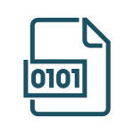



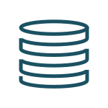
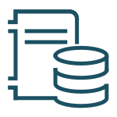


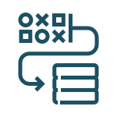





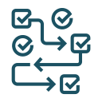

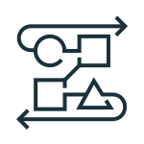

Databricks Data Intelligence Platform
Sources
Ingest
Transform
Query / Process
Serve
Analyse
Integrate
Data Intelligence Platform
ID Provider
Files / Logs (semi-structured)
Automation and Orchestration
Workflows and Jobs, CI/CD, MLOps
ID Provider
Sensors and IoT
(unstructured)
Batch and Streaming
(Lakeflow Connect, Auto Loader)
Data Science and AI / ML - Mosaic AI
Mosaic AI: GenAI, Model Serving
AI/BI
AI/BI Genie & Dashboards
Governance
ETL
RDBMS / DWH (structured)
Enterprise Catalog
Data Engineering and Processing
Spark/Photon, Lakeflow Declarative Pipelines
Data Warehousing
Databricks SQL
Business Apps
(structured)
AI Services
Batch and Streaming
Data Intelligence
Assistant, Predictive optimizations
Operational DB
Lakebase
Applications
Databricks Apps
Hugging Face
Media (unstructured)
Data and AI Governance - Unity Catalog
Unity Catalog: Access Control, Lineage, Audit
OpenAI
Ingest tool
Event Streaming
Operat. DB
BI
…
DWH
RDBMS
Federation
RDBMs
BI Tool
Orchestration
SaaS
HMS*
Data Management
Delta Lake, Iceberg, Uniform
Collaboration
Delta Sharing
Applications
KV store
External Orchestrator
Sharing
Market places
bronze
silver
gold
Business/AI App
Data Shares
Sharing Partner
* Hive Metastore
Cloud Storage
Data Consumer
Key:
3rd party
Storage
Databricks
Notes:
The reference architecture is structured along the dimensions “Source”, “Ingest”, “Transform”, “Query and Process”, “Serve”, “Analyse”, “Storage” and “Integration”
It maps capabilities into domains like “Batch & Streaming”, “Processing, ETL, Real-time Analysis”, “Data Warehousing”, “Data Science & Gen AI”, …
(1) Capabilities outside of the Data Intelligence Platform:
Sources:
Source systems that will be integrated via ETL pipelines
We distinguish between semi-structured and unstructured data (Sensors and IoT, Media, Files/Logs), and structured data (RDBMSs, Business Apps).
Additionally, some customer load data from other cloud providers.
No-ETL approach for data integration (federation)
Lakehouse Federation allows to access selected databases directly (without ETL and with query push down). Synapse and SQL Server are supported on Azure, but there are many more systems supported by Lakehouse Federation, e.g. Google BigQuery, Amazon Redshift, Postgres, My SQL, …
Storage:
Data will be stored in the cloud storage, i.e. ADLS on Azure
Ingest:
Streaming events from systems like “IoT Hub” and “Event Hub” can be directly read from Databricks via Structured Streaming.
For batch events “Azure Data Factory” and “Fabric Data Factory” can integrate with Databricks by executing notebooks, Python code or Java jar files as steps of the defined workflow. It is recommended to use Databricks workflows for all steps in the Databricks platform for better monitoring and integrated root cause analysis
Partner ingest tools like Fivetran help to extract data from enterprise source systems and ingest them into the Delta Lake
Serve:
The Databricks Intelligence Platform does not provide capabilities for generic OLTP and key-value databases. If such a capability is needed, transformed data can be pushed as the last step of an ETL pipeline into systems like SQL DB or Cosmos DB
Analysis:
Different business applications leverage the Data Intelligence Platform:
AI Apps and Gen AI Apps using e.g. Model Serving and Vector Search
BI use cases with standard tools like Power BI (but also using Databricks own dashboarding solution Lakeview)
Business Applications that need OLTP DBs or key-value stores, populated by ETL pipelines
3rd party data consumers using Delta Sharing directly or Marketplace or Clean rooms
(2) The Data Intelligence Platform
The Data Intelligence Platform covers all dimensions from Ingest to Serve and offers dashboarding for Analysis:
Storage:
Delta Lake is located on top of ADLS. ETL pipelines will use the so called “medallion architecture” to store data in a curated way as Delta files/tables.
Batch & Streaming
Ingest
Databricks Auto Loader allows to incrementally read files from object storage locations and works well together with Lakeflow Declarative Pipelines
The acquisition of Arcion added Data Replication capabilities which will be integrated into the Data Intelligence Platform in 2024
Processing, ETL, Real-time Analysis
Transform:
Due to its simplicity, a great choice for ETL is LDP with its declarative approach to building pipelines.
LDP integrates nicely with Auto Loader and comes with expectations to check data quality during ETL pipeline execution
Query and Process:
All workloads are covered by the Databricks Intelligence Platform and use the same Spark engine (and its API compatible native counterpart Photon).
They consistently use the same SQL language for all workloads in SQl Warehouses and via notebooks in workspaces
Workspaces additionally support Python, R and Scala
Data pipelines will be monitored via Lakehouse Monitoring
Data Warehousing
Serve
The Databricks Intelligence Platform provides “Databricks SQL” and its serverless version “Serverless SQL” as full Data Warehouse offerings for DWH/BI use cases.
Data Science & Gen AI
Mosaic AI supports end-to-end Machine Learning from data preparation to modeling and model serving for both traditional ML and Gen AI.
Transform
Feature engineering is supported with feature management in UC and “Feature Serving” (not shown in the diagram)
Modeling can be done with the most recent ML and AI Python libraries.
Mosaic AI also provides a low code AutoML capability.
Query and Process
The overall data science life cycle uses the common Lakehouse capabilities like Spark/Photon and Unity Catalog, and is supported by MLflow
Serve
“Model Serving” is a scalable enterprise grade model serving capability hosted in the Databricks Control Plane and supports CPU, GPU and LLM optimized serving. It also provides a unified API to access 3rd party LLMs.
“Feature Serving” (not shown) is also part of the Data Science serving capabilities
For RAG (Retrieval Augmented Generation) use cases, the platform offers “Vector Search”
MLOps (MLflow) is an open source MLOps platform integrated into the Data Intelligence Platform
As with data, ML assets will be monitored via Lakehouse Monitoring
Intelligence Engine:
A core component of the Databricks Data Intelligence Platform is the DatabricksIQ
DatabricksIQ uses generative AI to understand the semantics of your data. This is leveraged for example in the Databricks Assistant (context aware help) and Data Rooms (use of natural language for queries and dashboards)
Data and AI Governance:
Unity Catalog is the central data governance solution of Databricks providing important capabilities like metadata storage, data discovery, lineage tracking and fine grained access control.
Lakehouse Monitoring is the central monitoring capability across the platform. It allows to monitor, tables, features and models (via their inference tables)
Lakehouse Observability is the capability to access Lakehiouse lineage, logs and metrics via system tables.
Orchestration:
Databricks Workflows is a flexible workflow management solution running millions of orchestrated pipelines in production of Databricks’ customers. Furthermore, CI/CD support and the MLOps Stacks allow to orchestrate the supporting processes.
Collaboration:
Delta Sharing, the technology agnostic sharing solution provides enterprise grade, secure access to life data for partners
Delta Sharing is also the technical foundation of the Databricks Marketplace and Clean Rooms

Slide 10

Databricks Data Intelligence Platform
Sources
Ingest
Transform
Query / Process
Serve
Analyse
Integrate
Data Intelligence Platform
ID Provider
Files / Logs (semi-structured)
Automation and Orchestration
Lakeflow Jobs
CI/CD tools
DataOps
MLOps
ID Provider
Sensors and IoT
(unstructured)
Batch and Streaming
Data Science and AI / ML - Mosaic AI
AI/BI
Governance
AI Gateway
Feature Engineering
Traditional ML
Gen AI
Feature Serving
Vector Search
Model Serving
ETL
RDBMS / DWH (structured)
Lakeflow Connect
Dashboards
Enterprise Catalog
Data Engineering and Processing
Data Warehousing
Auto Loader
Lakeflow Declar- ative Pipelines
Spark / Photon
AI Functions
Databricks SQL
Connectors and APIs
Genie
AI Services
Business Apps
(structured)
Batch and Streaming
Data Intelligence
Operational DB
Applications
Assistant
Predictive optimization
Predictive IO
Lakebase
Databricks Apps
Hugging Face
Media (unstructured)
Data and AI Governance - Unity Catalog
OpenAI
Ingest tool
Event Streaming
Operat. DB
BI
…
DWH
RDBMS
Federation
Access Control
Catalog and Lineage
Data and AI Assets
Business Semantics
Quality Monitoring
Federation
RDBMs
BI Tool
Orchestration
SaaS
HMS*
Data Management
Collaboration
Applications
Delta Lake
Iceberg
Delta Sharing
Market place
bronze
silver
gold
Clean Rooms
KV store
External Orchestrator
Sharing
Market places
Business/AI App
Data Shares
Sharing Partner
* Hive Metastore
Cloud Storage
Data Consumer
Key:
3rd party
Storage
Databricks
Notes:
The reference architecture is structured along the dimensions “Source”, “Ingest”, “Transform”, “Query and Process”, “Serve”, “Analyse”, “Storage” and “Integration”
It maps capabilities into domains like “Batch & Streaming”, “Processing, ETL, Real-time Analysis”, “Data Warehousing”, “Data Science & Gen AI”, …
(1) Capabilities outside of the Data Intelligence Platform:
Sources:
Source systems that will be integrated via ETL pipelines
We distinguish between semi-structured and unstructured data (Sensors and IoT, Media, Files/Logs), and structured data (RDBMSs, Business Apps).
Additionally, some customer load data from other cloud providers.
No-ETL approach for data integration (federation)
Lakehouse Federation allows to access selected databases directly (without ETL and with query push down). Synapse and SQL Server are supported on Azure, but there are many more systems supported by Lakehouse Federation, e.g. Google BigQuery, Amazon Redshift, Postgres, My SQL, …
Storage:
Data will be stored in the cloud storage, i.e. ADLS on Azure
Ingest:
Streaming events from systems like “IoT Hub” and “Event Hub” can be directly read from Databricks via Structured Streaming.
For batch events “Azure Data Factory” and “Fabric Data Factory” can integrate with Databricks by executing notebooks, Python code or Java jar files as steps of the defined workflow. It is recommended to use Databricks workflows for all steps in the Databricks platform for better monitoring and integrated root cause analysis
Partner ingest tools like Fivetran help to extract data from enterprise source systems and ingest them into the Delta Lake
Serve:
The Databricks Intelligence Platform does not provide capabilities for generic OLTP and key-value databases. If such a capability is needed, transformed data can be pushed as the last step of an ETL pipeline into systems like SQL DB or Cosmos DB
Analysis:
Different business applications leverage the Data Intelligence Platform:
AI Apps and Gen AI Apps using e.g. Model Serving and Vector Search
BI use cases with standard tools like Power BI (but also using Databricks own dashboarding solution Lakeview)
Business Applications that need OLTP DBs or key-value stores, populated by ETL pipelines
3rd party data consumers using Delta Sharing directly or Marketplace or Clean rooms
(2) The Data Intelligence Platform
The Data Intelligence Platform covers all dimensions from Ingest to Serve and offers dashboarding for Analysis:
Storage:
Delta Lake is located on top of ADLS. ETL pipelines will use the so called “medallion architecture” to store data in a curated way as Delta files/tables.
Batch & Streaming
Ingest
Databricks Auto Loader allows to incrementally read files from object storage locations and works well together with Lakeflow Declarative Pipelines
The acquisition of Arcion added Data Replication capabilities which will be integrated into the Data Intelligence Platform in 2024
Processing, ETL, Real-time Analysis
Transform:
Due to its simplicity, a great choice for ETL is LDP with its declarative approach to building pipelines.
LDP integrates nicely with Auto Loader and comes with expectations to check data quality during ETL pipeline execution
Query and Process:
All workloads are covered by the Databricks Intelligence Platform and use the same Spark engine (and its API compatible native counterpart Photon).
They consistently use the same SQL language for all workloads in SQl Warehouses and via notebooks in workspaces
Workspaces additionally support Python, R and Scala
Data pipelines will be monitored via Lakehouse Monitoring
Data Warehousing
Serve
The Databricks Intelligence Platform provides “Databricks SQL” and its serverless version “Serverless SQL” as full Data Warehouse offerings for DWH/BI use cases.
Data Science & Gen AI
Mosaic AI supports end-to-end Machine Learning from data preparation to modeling and model serving for both traditional ML and Gen AI.
Transform
Feature engineering is supported with feature management in UC and “Feature Serving” (not shown in the diagram)
Modeling can be done with the most recent ML and AI Python libraries.
Mosaic AI also provides a low code AutoML capability.
Query and Process
The overall data science life cycle uses the common Lakehouse capabilities like Spark/Photon and Unity Catalog, and is supported by MLflow
Serve
“Model Serving” is a scalable enterprise grade model serving capability hosted in the Databricks Control Plane and supports CPU, GPU and LLM optimized serving. It also provides a unified API to access 3rd party LLMs.
“Feature Serving” (not shown) is also part of the Data Science serving capabilities
For RAG (Retrieval Augmented Generation) use cases, the platform offers “Vector Search”
MLOps (MLflow) is an open source MLOps platform integrated into the Data Intelligence Platform
As with data, ML assets will be monitored via Lakehouse Monitoring
Intelligence Engine:
A core component of the Databricks Data Intelligence Platform is the DatabricksIQ
DatabricksIQ uses generative AI to understand the semantics of your data. This is leveraged for example in the Databricks Assistant (context aware help) and Data Rooms (use of natural language for queries and dashboards)
Data and AI Governance:
Unity Catalog is the central data governance solution of Databricks providing important capabilities like metadata storage, data discovery, lineage tracking and fine grained access control.
Lakehouse Monitoring is the central monitoring capability across the platform. It allows to monitor, tables, features and models (via their inference tables)
Lakehouse Observability is the capability to access Lakehiouse lineage, logs and metrics via system tables.
Orchestration:
Databricks Workflows is a flexible workflow management solution running millions of orchestrated pipelines in production of Databricks’ customers. Furthermore, CI/CD support and the MLOps Stacks allow to orchestrate the supporting processes.
Collaboration:
Delta Sharing, the technology agnostic sharing solution provides enterprise grade, secure access to life data for partners
Delta Sharing is also the technical foundation of the Databricks Marketplace and Clean Rooms

Slide 11






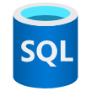
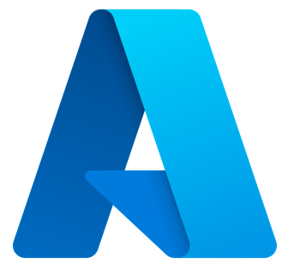



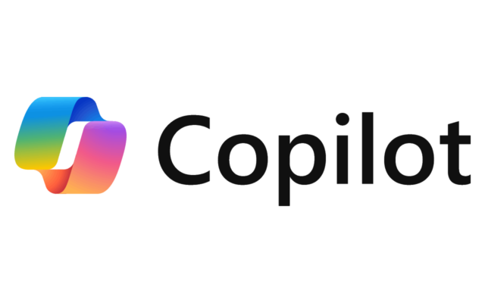


Databricks Data Intelligence Platform
Sources
Ingest
Transform
Query / Process
Serve
Analyse
Integrate
Data Intelligence Platform
ID Provider
Files / Logs (semi-structured)
Automation and Orchestration
Lakeflow Jobs
CI/CD tools
DataOps
MLOps
Entra ID
Sensors and IoT
(unstructured)
Batch and Streaming
Data Science and AI / ML - Mosaic AI
AI/BI
Governance
AI Gateway
Feature Engineering
Traditional ML
Gen AI
Feature Serving
Vector Search
Model Serving
ETL
RDBMS / DWH (structured)
Lakeflow Connect
Dashboards
Purview
Data Engineering and Processing
Data Warehousing
Auto Loader
Lakeflow Declar- ative Pipelines
Spark / Photon
AI Functions
Databricks SQL
Connectors and APIs
Genie
AI Services
Business Apps
(structured)
Batch and Streaming
Data Intelligence
Operational DB
Applications
Assistant
Predictive optimization
Predictive IO
Lakebase
Databricks Apps
Hugging Face
Media (unstructured)
IoT Hub
Event Hub
Data and AI Governance - Unity Catalog
OpenAI
Operat. DB
BI
…
Synapse
SQL Server
Federation
Access Control
Catalog and Lineage
Data and AI Assets
Business Semantics
Quality Monitoring
Federation
Azure Data Factory
Fabric Data Factory
Power BI+Copilot
HMS*
Data Management
Collaboration
SQL DB
Orchestration
Market place
Applications
Delta Lake
Iceberg
bronze
silver
gold
Delta Sharing
Clean Rooms
Cosmos DB
Sharing
Business/AI App
External Orchestrator
Market places
Data Shares
Sharing Partner
* Hive Metastore
ADLS Gen 2
Data Consumer
Key:
3rd party
Storage
Databricks
Notes:
The reference architecture is structured along the dimensions “Source”, “Ingest”, “Transform”, “Query and Process”, “Serve”, “Analyse”, “Storage” and “Integration”
It maps capabilities into domains like “Batch & Streaming”, “Processing, ETL, Real-time Analysis”, “Data Warehousing”, “Data Science & Gen AI”, …
(1) Capabilities outside of the Data Intelligence Platform:
Sources:
Source systems that will be integrated via ETL pipelines
We distinguish between semi-structured and unstructured data (Sensors and IoT, Media, Files/Logs), and structured data (RDBMSs, Business Apps).
Additionally, some customer load data from other cloud providers.
No-ETL approach for data integration (federation)
Lakehouse Federation allows to access selected databases directly (without ETL and with query push down). Synapse and SQL Server are supported on Azure, but there are many more systems supported by Lakehouse Federation, e.g. Google BigQuery, Amazon Redshift, Postgres, My SQL, …
Storage:
Data will be stored in the cloud storage, i.e. ADLS on Azure
Ingest:
Streaming events from systems like “IoT Hub” and “Event Hub” can be directly read from Databricks via Structured Streaming.
For batch events “Azure Data Factory” and “Fabric Data Factory” can integrate with Databricks by executing notebooks, Python code or Java jar files as steps of the defined workflow. It is recommended to use Lakeflow Jobs for all steps in the Databricks platform for better monitoring and integrated root cause analysis
Partner ingest tools like Fivetran help to extract data from enterprise source systems and ingest them into the Delta Lake
Serve:
The Databricks Intelligence Platform does not provide capabilities for generic OLTP and key-value databases. If such a capability is needed, transformed data can be pushed as the last step of an ETL pipeline into systems like SQL DB or Cosmos DB
Analysis:
Different business applications leverage the Data Intelligence Platform:
AI Apps and Gen AI Apps using e.g. Model Serving and Vector Search
BI use cases with standard tools like Power BI (but also using Databricks own dashboarding solution Lakeview)
Business Applications that need OLTP DBs or key-value stores, populated by ETL pipelines
3rd party data consumers using Delta Sharing directly or Marketplace or Clean rooms
(2) The Data Intelligence Platform
The Data Intelligence Platform covers all dimensions from Ingest to Serve and offers dashboarding for Analysis:
Storage:
Delta Lake is located on top of ADLS. ETL pipelines will use the so called “medallion architecture” to store data in a curated way as Delta files/tables.
Batch & Streaming
Ingest
Databricks Auto Loader allows to incrementally read files from object storage locations and works well together with Lakeflow Declarative Pipelines
The acquisition of Arcion added Data Replication capabilities which will be integrated into the Data Intelligence Platform in 2024
Processing, ETL, Real-time Analysis
Transform:
Due to its simplicity, a great choice for ETL is LDP with its declarative approach to building pipelines.
LDP integrates nicely with Auto Loader and comes with expectations to check data quality during ETL pipeline execution
Query and Process:
All workloads are covered by the Databricks Intelligence Platform and use the same Spark engine (and its API compatible native counterpart Photon).
They consistently use the same SQL language for all workloads in SQl Warehouses and via notebooks in workspaces
Workspaces additionally support Python, R and Scala
Data pipelines will be monitored via Lakehouse Monitoring
Data Warehousing
Serve
The Databricks Intelligence Platform provides “Databricks SQL” and its serverless version “Serverless SQL” as full Data Warehouse offerings for DWH/BI use cases.
Data Science & Gen AI
Mosaic AI supports end-to-end Machine Learning from data preparation to modeling and model serving for both traditional ML and Gen AI.
Transform
Feature engineering is supported with feature management in UC and “Feature Serving” (not shown in the diagram)
Modeling can be done with the most recent ML and AI Python libraries.
Mosaic AI also provides a low code AutoML capability.
Query and Process
The overall data science life cycle uses the common Lakehouse capabilities like Spark/Photon and Unity Catalog, and is supported by MLflow
Serve
“Model Serving” is a scalable enterprise grade model serving capability hosted in the Databricks Control Plane and supports CPU, GPU and LLM optimized serving. It also provides a unified API to access 3rd party LLMs.
“Feature Serving” (not shown) is also part of the Data Science serving capabilities
For RAG (Retrieval Augmented Generation) use cases, the platform offers “Vector Search”
MLOps (MLflow) is an open source MLOps platform integrated into the Data Intelligence Platform
As with data, ML assets will be monitored via Lakehouse Monitoring
Intelligence Engine:
A core component of the Databricks Data Intelligence Platform is the DatabricksIQ
DatabricksIQ uses generative AI to understand the semantics of your data. This is leveraged for example in the Databricks Assistant (context aware help) and Data Rooms (use of natural language for queries and dashboards)
Data and AI Governance:
Unity Catalog is the central data governance solution of Databricks providing important capabilities like metadata storage, data discovery, lineage tracking and fine grained access control.
Lakehouse Monitoring is the central monitoring capability across the platform. It allows to monitor, tables, features and models (via their inference tables)
Lakehouse Observability is the capability to access Lakehiouse lineage, logs and metrics via system tables.
Orchestration:
Lakeflow Jobs is a flexible workflow management solution running millions of orchestrated pipelines in production of Databricks’ customers. Furthermore, CI/CD support and the MLOps Stacks allow to orchestrate the supporting processes.
Collaboration:
Delta Sharing, the technology agnostic sharing solution provides enterprise grade, secure access to life data for partners
Delta Sharing is also the technical foundation of the Databricks Marketplace and Clean Rooms

Slide 12





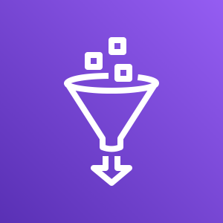
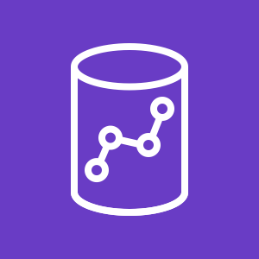


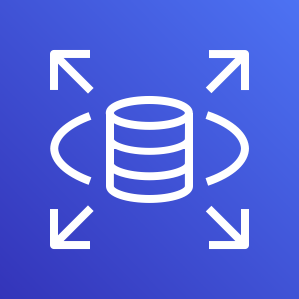

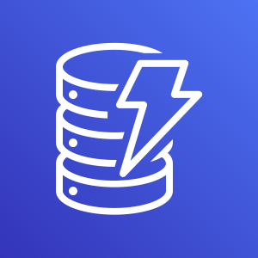
Databricks Data Intelligence Platform
Sources
Ingest
Transform
Query / Process
Serve
Analyse
Integrate
Data Intelligence Platform
ID Provider
Files / Logs (semi-structured)
Automation and Orchestration
Lakeflow Jobs
CI/CD tools
DataOps
MLOps
IAM Identity Center
Sensors and IoT
(unstructured)
Batch and Streaming
Data Science and AI / ML - Mosaic AI
AI/BI
Governance
AI Gateway
Feature Engineering
Traditional ML
Gen AI
Feature Serving
Vector Search
Model Serving
ETL
RDBMS / DWH (structured)
Lakeflow Connect
Dashboards
Enterprise Catalog
Data Engineering and Processing
Data Warehousing
Auto Loader
Lakeflow Declar- ative Pipelines
Spark / Photon
AI Functions
Databricks SQL
Connectors and APIs
Genie
AI Services
Business Apps
(structured)
Batch and Streaming
Data Intelligence
Operational DB
Applications
Assistant
Predictive optimization
Predictive IO
Lakebase
Databricks Apps
Hugging Face
Media (unstructured)
Amazon AppFlow
AWS DMS
Data and AI Governance - Unity Catalog
Operat. DB
BI
Amazon Bedrock
Federation
Access Control
Catalog and Lineage
Data and AI Assets
Business Semantics
Quality Monitoring
…
Federation
Amazon QuickSight
AWS Glue
Amazon Redshift
AWS IoT Core
Amazon Kinesis
Data Management
Collaboration
Amazon RDS
Orchestration
Market place
Applications
Delta Lake
Iceberg
bronze
silver
gold
Delta Sharing
Clean Rooms
Amazon DynamoDB
Sharing
Business/AI App
External Orchestrator
Market places
Data Shares
Sharing Partner
Amazon S3
Data Consumer
Key:
3rd party
Storage
Databricks
Notes:
The reference architecture is structured along the dimensions “Source”, “Ingest”, “Transform”, “Query and Process”, “Serve”, “Analyse”, “Storage” and “Integration”
It maps capabilities into domains like “Batch & Streaming”, “Processing, ETL, Real-time Analysis”, “Data Warehousing”, “Data Science & Gen AI”, …
(1) Capabilities outside of the Data Intelligence Platform:
Sources:
Source systems that will be integrated via ETL pipelines
We distinguish between semi-structured and unstructured data (Sensors and IoT, Media, Files/Logs), and structured data (RDBMSs, Business Apps).
Additionally, some customer load data from other cloud providers.
No-ETL approach for data integration (federation)
Lakehouse Federation allows to access selected databases directly (without ETL and with query push down). Synapse and SQL Server are supported on Azure, but there are many more systems supported by Lakehouse Federation, e.g. Google BigQuery, Amazon Redshift, Postgres, My SQL, …
Storage:
Data will be stored in the cloud storage, i.e. ADLS on Azure
Ingest:
Streaming events from systems like “IoT Hub” and “Event Hub” can be directly read from Databricks via Structured Streaming.
For batch events “Azure Data Factory” and “Fabric Data Factory” can integrate with Databricks by executing notebooks, Python code or Java jar files as steps of the defined workflow. It is recommended to use Databricks workflows for all steps in the Databricks platform for better monitoring and integrated root cause analysis
Partner ingest tools like Fivetran help to extract data from enterprise source systems and ingest them into the Delta Lake
Serve:
The Databricks Intelligence Platform does not provide capabilities for generic OLTP and key-value databases. If such a capability is needed, transformed data can be pushed as the last step of an ETL pipeline into systems like SQL DB or Cosmos DB
Analysis:
Different business applications leverage the Data Intelligence Platform:
AI Apps and Gen AI Apps using e.g. Model Serving and Vector Search
BI use cases with standard tools like Power BI (but also using Databricks own dashboarding solution Lakeview)
Business Applications that need OLTP DBs or key-value stores, populated by ETL pipelines
3rd party data consumers using Delta Sharing directly or Marketplace or Clean rooms
(2) The Data Intelligence Platform
The Data Intelligence Platform covers all dimensions from Ingest to Serve and offers dashboarding for Analysis:
Storage:
Delta Lake is located on top of ADLS. ETL pipelines will use the so called “medallion architecture” to store data in a curated way as Delta files/tables.
Batch & Streaming
Ingest
Databricks Auto Loader allows to incrementally read files from object storage locations and works well together with Lakeflow Declarative Pipelines
The acquisition of Arcion added Data Replication capabilities which will be integrated into the Data Intelligence Platform in 2024
Processing, ETL, Real-time Analysis
Transform:
Due to its simplicity, a great choice for ETL is LDP with its declarative approach to building pipelines.
LDP integrates nicely with Auto Loader and comes with expectations to check data quality during ETL pipeline execution
Query and Process:
All workloads are covered by the Databricks Intelligence Platform and use the same Spark engine (and its API compatible native counterpart Photon).
They consistently use the same SQL language for all workloads in SQl Warehouses and via notebooks in workspaces
Workspaces additionally support Python, R and Scala
Data pipelines will be monitored via Lakehouse Monitoring
Data Warehousing
Serve
The Databricks Intelligence Platform provides “Databricks SQL” and its serverless version “Serverless SQL” as full Data Warehouse offerings for DWH/BI use cases.
Data Science & Gen AI
Mosaic AI supports end-to-end Machine Learning from data preparation to modeling and model serving for both traditional ML and Gen AI.
Transform
Feature engineering is supported with feature management in UC and “Feature Serving” (not shown in the diagram)
Modeling can be done with the most recent ML and AI Python libraries.
Mosaic AI also provides a low code AutoML capability.
Query and Process
The overall data science life cycle uses the common Lakehouse capabilities like Spark/Photon and Unity Catalog, and is supported by MLflow
Serve
“Model Serving” is a scalable enterprise grade model serving capability hosted in the Databricks Control Plane and supports CPU, GPU and LLM optimized serving. It also provides a unified API to access 3rd party LLMs.
“Feature Serving” (not shown) is also part of the Data Science serving capabilities
For RAG (Retrieval Augmented Generation) use cases, the platform offers “Vector Search”
MLOps (MLflow) is an open source MLOps platform integrated into the Data Intelligence Platform
As with data, ML assets will be monitored via Lakehouse Monitoring
Intelligence Engine:
A core component of the Databricks Data Intelligence Platform is the DatabricksIQ
DatabricksIQ uses generative AI to understand the semantics of your data. This is leveraged for example in the Databricks Assistant (context aware help) and Data Rooms (use of natural language for queries and dashboards)
Data and AI Governance:
Unity Catalog is the central data governance solution of Databricks providing important capabilities like metadata storage, data discovery, lineage tracking and fine grained access control.
Lakehouse Monitoring is the central monitoring capability across the platform. It allows to monitor, tables, features and models (via their inference tables)
Lakehouse Observability is the capability to access Lakehiouse lineage, logs and metrics via system tables.
Orchestration:
Lakeflow Jobs is a flexible workflow management solution running millions of orchestrated pipelines in production of Databricks’ customers. Furthermore, CI/CD support and the MLOps Stacks allow to orchestrate the supporting processes.
Collaboration:
Delta Sharing, the technology agnostic sharing solution provides enterprise grade, secure access to life data for partners
Delta Sharing is also the technical foundation of the Databricks Marketplace and Clean Rooms

Slide 13
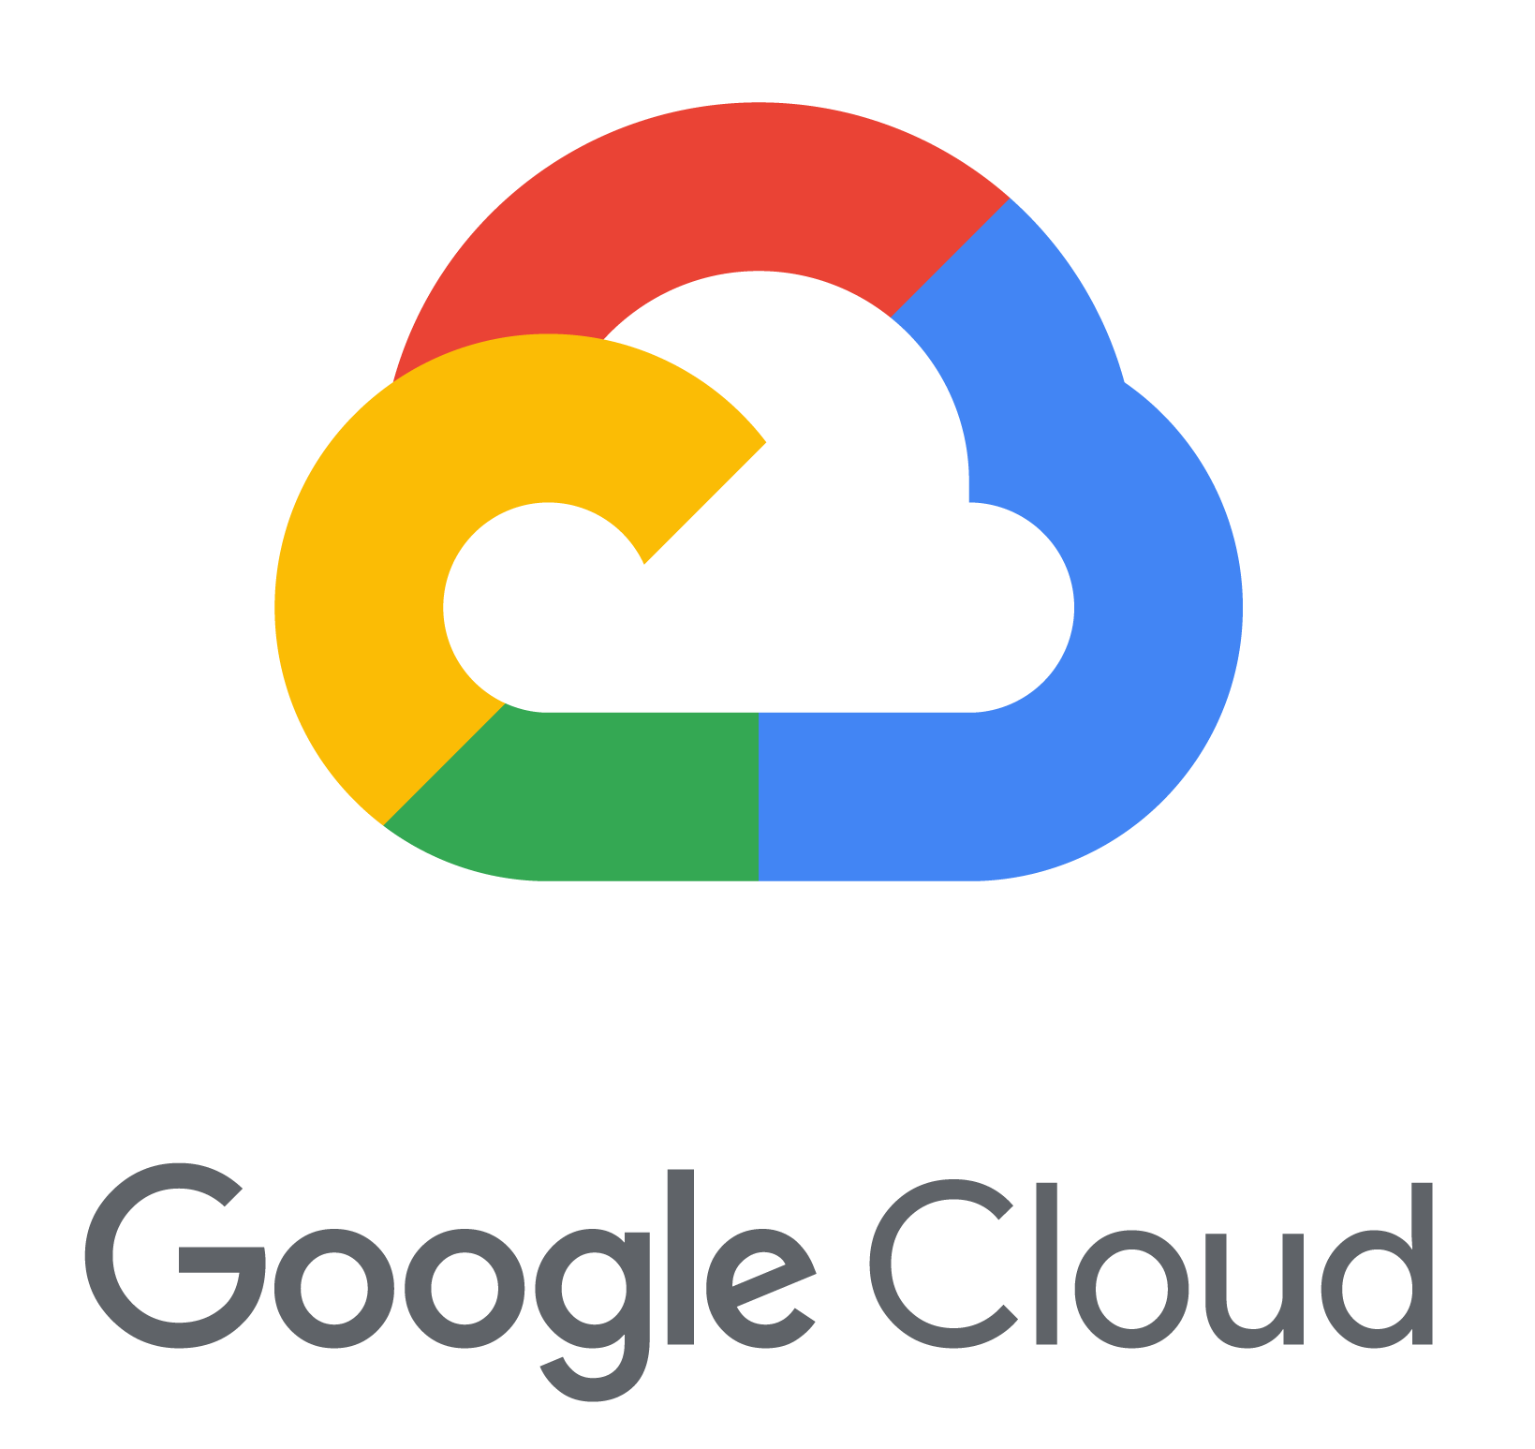

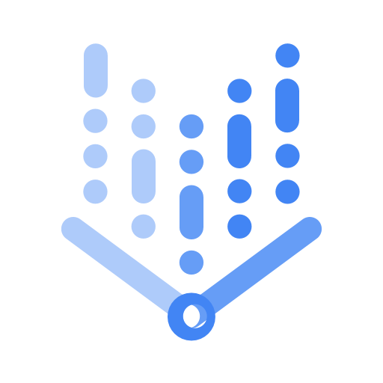




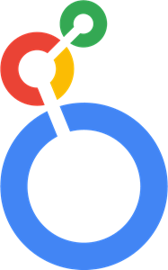



Databricks Data Intelligence Platform
Sources
Ingest
Transform
Query / Process
Serve
Analyse
Integrate
Data Intelligence Platform
ID Provider
Files / Logs (semi-structured)
Automation and Orchestration
Lakeflow Jobs
CI/CD tools
DataOps
MLOps
ID Provider
Sensors and IoT
(unstructured)
Batch and Streaming
Data Science and AI / ML - Mosaic AI
AI/BI
Governance
AI Gateway
Feature Engineering
Traditional ML
Gen AI
Vector Search
Model Serving
ETL
RDBMS / DWH (structured)
Lakeflow Connect
Dashboards
Enterprise Catalog
Data Engineering and Processing
Data Warehousing
Auto Loader
Lakeflow Declar- ative Pipelines
Spark / Photon
AI Functions
Databricks SQL
Connectors and APIs
Genie
AI Services
Business Apps
(structured)
Batch and Streaming
Data Intelligence
Operational DB
Applications
Assistant
Predictive optimization
Predictive IO
Databricks Apps
Hugging Face
Media (unstructured)
Cloud Data Fusion
Data and AI Governance - Unity Catalog
Vertex AI
Operat. DB
BI
…
Federation
Access Control
Catalog and Lineage
Data and AI Assets
Business Semantics
Quality Monitoring
Federation
BigQuery
Looker
HMS*
Pub/Sub
Data stream
Data Management
Collaboration
Cloud BigTable
Orchestration
Market place
Applications
Delta Lake
Iceberg
bronze
silver
gold
Delta Sharing
Clean Rooms
Cloud SQL
Data store
Sharing
Business/AI App
External Orchestrator
Market places
Data Shares
Sharing Partner
* Hive Metastore
Google Cloud Storage
Data Consumer
Key:
3rd party
Storage
Databricks
Notes:
The reference architecture is structured along the dimensions “Source”, “Ingest”, “Transform”, “Query and Process”, “Serve”, “Analyse”, “Storage” and “Integration”
It maps capabilities into domains like “Batch & Streaming”, “Processing, ETL, Real-time Analysis”, “Data Warehousing”, “Data Science & Gen AI”, …
(1) Capabilities outside of the Data Intelligence Platform:
Sources:
Source systems that will be integrated via ETL pipelines
We distinguish between semi-structured and unstructured data (Sensors and IoT, Media, Files/Logs), and structured data (RDBMSs, Business Apps).
Additionally, some customer load data from other cloud providers.
No-ETL approach for data integration (federation)
Lakehouse Federation allows to access selected databases directly (without ETL and with query push down). Synapse and SQL Server are supported on Azure, but there are many more systems supported by Lakehouse Federation, e.g. Google BigQuery, Amazon Redshift, Postgres, My SQL, …
Storage:
Data will be stored in the cloud storage, i.e. ADLS on Azure
Ingest:
Streaming events from systems like “IoT Hub” and “Event Hub” can be directly read from Databricks via Structured Streaming.
For batch events “Azure Data Factory” and “Fabric Data Factory” can integrate with Databricks by executing notebooks, Python code or Java jar files as steps of the defined workflow. It is recommended to use Databricks workflows for all steps in the Databricks platform for better monitoring and integrated root cause analysis
Partner ingest tools like Fivetran help to extract data from enterprise source systems and ingest them into the Delta Lake
Serve:
The Databricks Intelligence Platform does not provide capabilities for generic OLTP and key-value databases. If such a capability is needed, transformed data can be pushed as the last step of an ETL pipeline into systems like SQL DB or Cosmos DB
Analysis:
Different business applications leverage the Data Intelligence Platform:
AI Apps and Gen AI Apps using e.g. Model Serving and Vector Search
BI use cases with standard tools like Power BI (but also using Databricks own dashboarding solution Lakeview)
Business Applications that need OLTP DBs or key-value stores, populated by ETL pipelines
3rd party data consumers using Delta Sharing directly or Marketplace or Clean rooms
(2) The Data Intelligence Platform
The Data Intelligence Platform covers all dimensions from Ingest to Serve and offers dashboarding for Analysis:
Storage:
Delta Lake is located on top of ADLS. ETL pipelines will use the so called “medallion architecture” to store data in a curated way as Delta files/tables.
Batch & Streaming
Ingest
Databricks Auto Loader allows to incrementally read files from object storage locations and works well together with Lakeflow Declarative Pipelines
The acquisition of Arcion added Data Replication capabilities which will be integrated into the Data Intelligence Platform in 2024
Processing, ETL, Real-time Analysis
Transform:
Due to its simplicity, a great choice for ETL is LDP with its declarative approach to building pipelines.
LDP integrates nicely with Auto Loader and comes with expectations to check data quality during ETL pipeline execution
Query and Process:
All workloads are covered by the Databricks Intelligence Platform and use the same Spark engine (and its API compatible native counterpart Photon).
They consistently use the same SQL language for all workloads in SQl Warehouses and via notebooks in workspaces
Workspaces additionally support Python, R and Scala
Data pipelines will be monitored via Lakehouse Monitoring
Data Warehousing
Serve
The Databricks Intelligence Platform provides “Databricks SQL” and its serverless version “Serverless SQL” as full Data Warehouse offerings for DWH/BI use cases.
Data Science & Gen AI
Mosaic AI supports end-to-end Machine Learning from data preparation to modeling and model serving for both traditional ML and Gen AI.
Transform
Feature engineering is supported with feature management in UC and “Feature Serving” (not shown in the diagram)
Modeling can be done with the most recent ML and AI Python libraries.
Mosaic AI also provides a low code AutoML capability.
Query and Process
The overall data science life cycle uses the common Lakehouse capabilities like Spark/Photon and Unity Catalog, and is supported by MLflow
Serve
“Model Serving” is a scalable enterprise grade model serving capability hosted in the Databricks Control Plane and supports CPU, GPU and LLM optimized serving. It also provides a unified API to access 3rd party LLMs.
“Feature Serving” (not shown) is also part of the Data Science serving capabilities
For RAG (Retrieval Augmented Generation) use cases, the platform offers “Vector Search”
MLOps (MLflow) is an open source MLOps platform integrated into the Data Intelligence Platform
As with data, ML assets will be monitored via Lakehouse Monitoring
Intelligence Engine:
A core component of the Databricks Data Intelligence Platform is the DatabricksIQ
DatabricksIQ uses generative AI to understand the semantics of your data. This is leveraged for example in the Databricks Assistant (context aware help) and Data Rooms (use of natural language for queries and dashboards)
Data and AI Governance:
Unity Catalog is the central data governance solution of Databricks providing important capabilities like metadata storage, data discovery, lineage tracking and fine grained access control.
Lakehouse Monitoring is the central monitoring capability across the platform. It allows to monitor, tables, features and models (via their inference tables)
Lakehouse Observability is the capability to access Lakehiouse lineage, logs and metrics via system tables.
Orchestration:
Lakeflow Jobs is a flexible workflow management solution running millions of orchestrated pipelines in production of Databricks’ customers. Furthermore, CI/CD support and the MLOps Stacks allow to orchestrate the supporting processes.
Collaboration:
Delta Sharing, the technology agnostic sharing solution provides enterprise grade, secure access to life data for partners
Delta Sharing is also the technical foundation of the Databricks Marketplace and Clean Rooms

Slide 14
Architectural Assets
go/system-arch System Architecture of Databricks
go/arch-center Architecture Center (architectural assets with explanations)
- Architecture Positioning
- Guiding Principles
- Reference Architectures
- Well-Architected Lakehouse
- System Architecture (go/system-arch)
- Architecture Patterns

Slide 15
Template

Slide 16
> Use Layout ⇒ Reference Architecture Layout <

Slide 17
Slide with applied layout and icons added
Lakeflow Jobs
CI/CD tools
DataOps
MLOps
AI Gateway
Feature Engineering
Traditional ML
Gen AI
Vector Search
Model Serving
Lakeflow Connect
Dashboards
Auto Loader
Lakeflow Declar- ative Pipelines
Spark / Photon
AI Functions
Databricks SQL
Connectors and APIs
Genie
Assistant
Predictive optimization
Predictive IO
Databricks Apps
Federation
Access Control
Catalog and Lineage
Data and AI Assets
Business Semantics
Quality Monitoring
Delta Lake
Iceberg
Delta Sharing
Market place
Clean Rooms

Slide 18
> Use Layout ⇒ Reference Architecture Layout (2) <

Slide 19

> The other icons <
Integrate
ID Provider
Files / Logs (semi-structured)
ID Provider
Sensors and IoT
(unstructured)
Governance
Enterprise Catalog
RDBMS (structured)
ETL
AI Services
Business Apps
(structured)
Hugging Face
BI
Media (unstructured)
OpenAI
BI Tool
…
Operat. DBs
Business Apps
Orchestration
Other clouds
RDBMs, KV store
Business/AI App
External Orchestrator
3rd party
Federation
RDBMS
Data Consumer

Slide 20
Most used icons

Slide 21
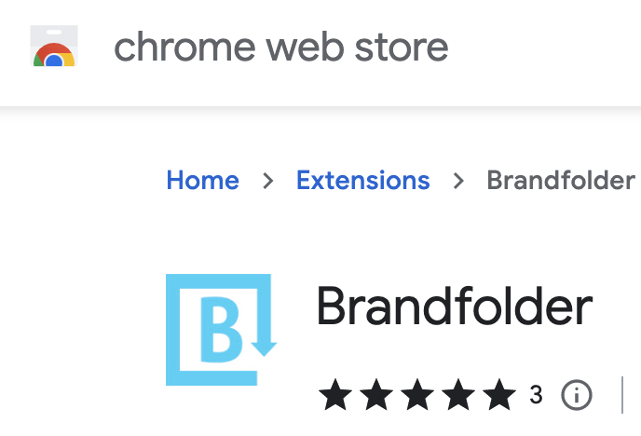
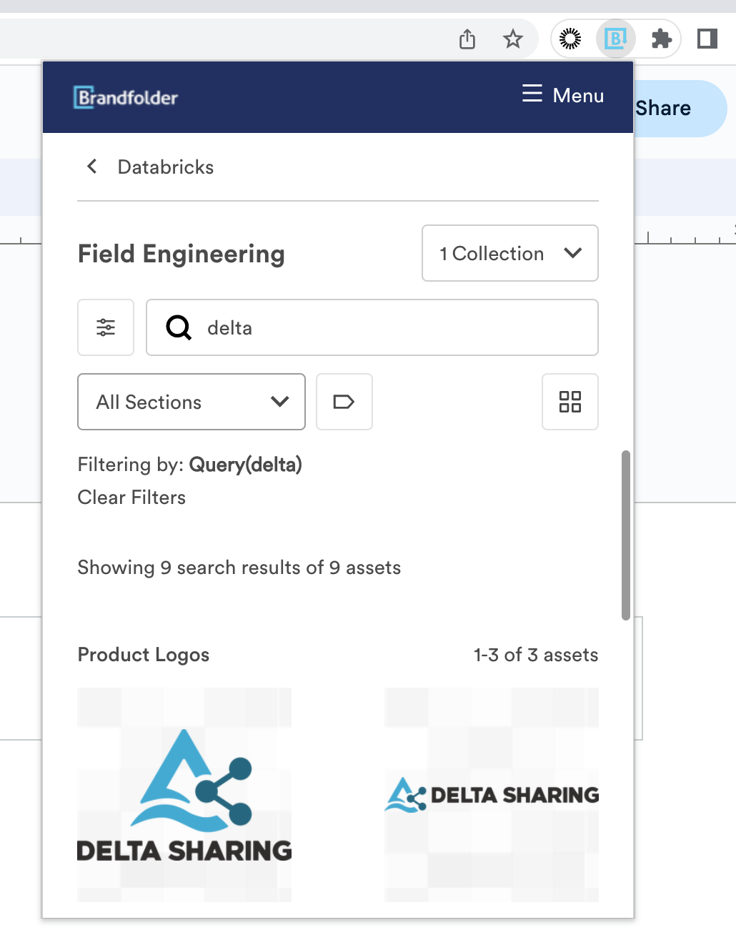
The Digital Asset Chrome Plugin
https://brandfolder.com/integrations/chrome-extension

Slide 22
Alternatives

Slide 23







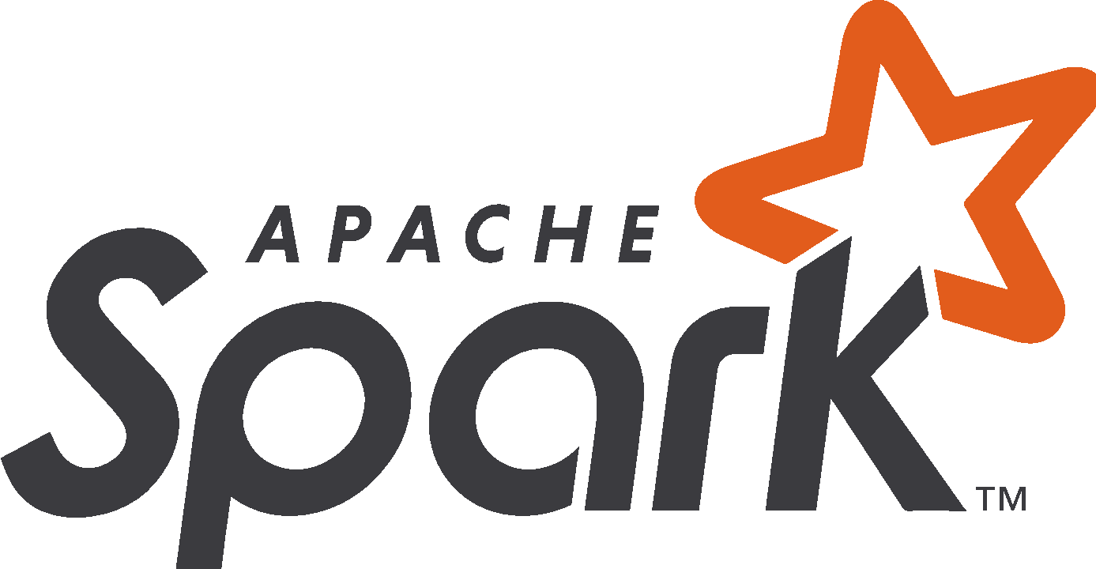


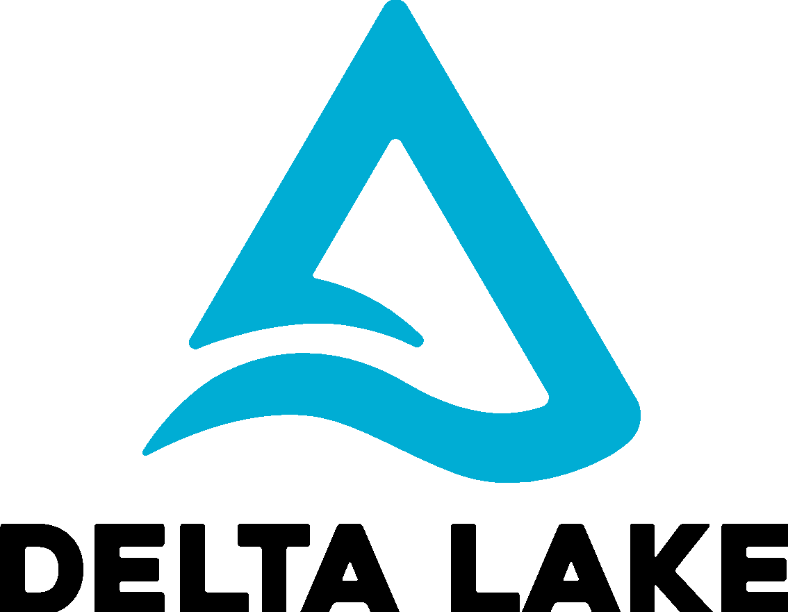

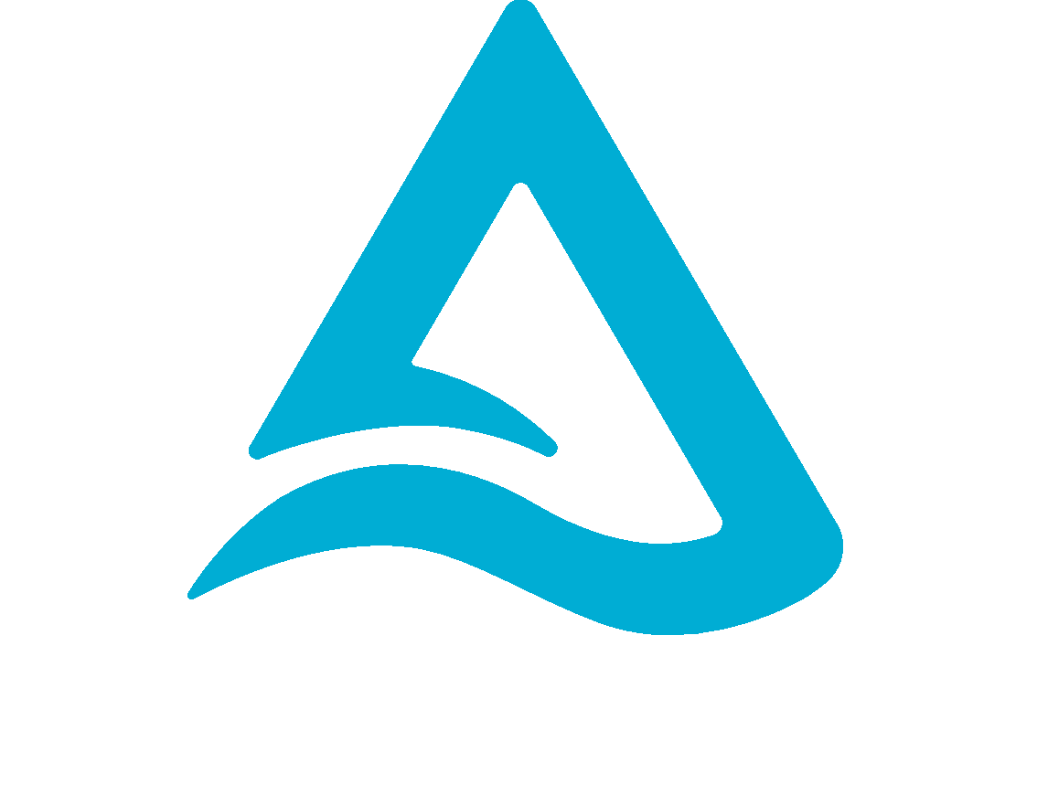
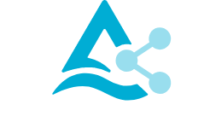

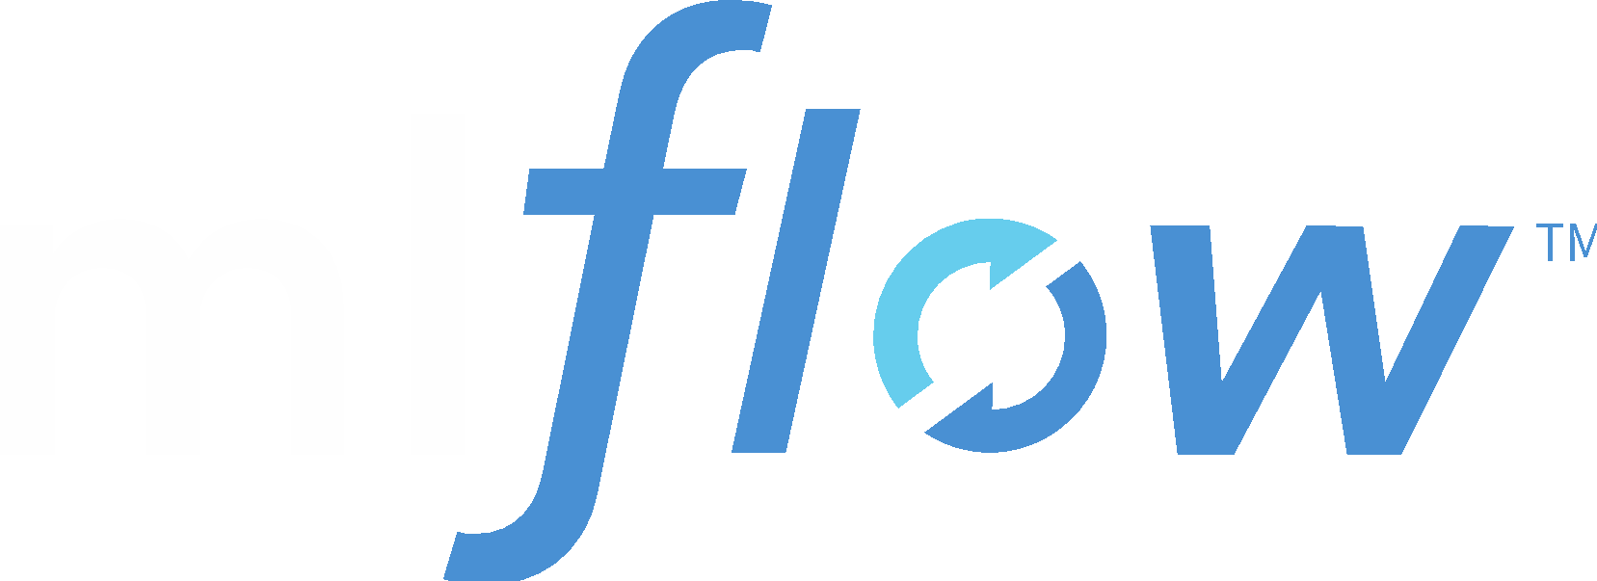

Databricks Logos
Photon
Photon

Slide 24


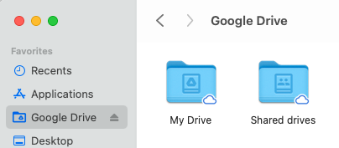


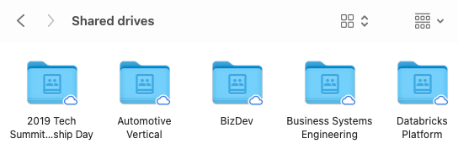




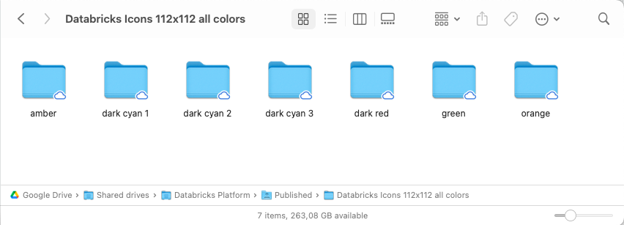




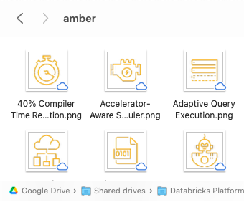



Databricks Icons - Links to 112*112 PNGs
Mac
Finder
1B3139
Google Drive > Shared Drives > Databricks Platform > Published > Databricks Icons 112x112 all colors > dark cyan 3
1B5162
Google Drive > Shared Drives > Databricks Platform > Published > Databricks Icons 112x112 all colors > dark cyan 2
618794
Google Drive > Shared Drives > Databricks Platform > Published > Databricks Icons 112x112 all colors > dark cyan 1
FF3621
Google Drive > Shared Drives > Databricks Platform > Published > Databricks Icons 112x112 all colors > orange
FFAB00
Google Drive > Shared Drives > Databricks Platform > Published > Databricks Icons 112x112 all colors > amber
00A972
Google Drive > Shared Drives > Databricks Platform > Published > Databricks Icons 112x112 all colors > green
Google slides
98102A
Google Drive > Shared Drives > Databricks Platform > Published > Databricks Icons 112x112 all colors > dark red
drag & drop

Slide 25
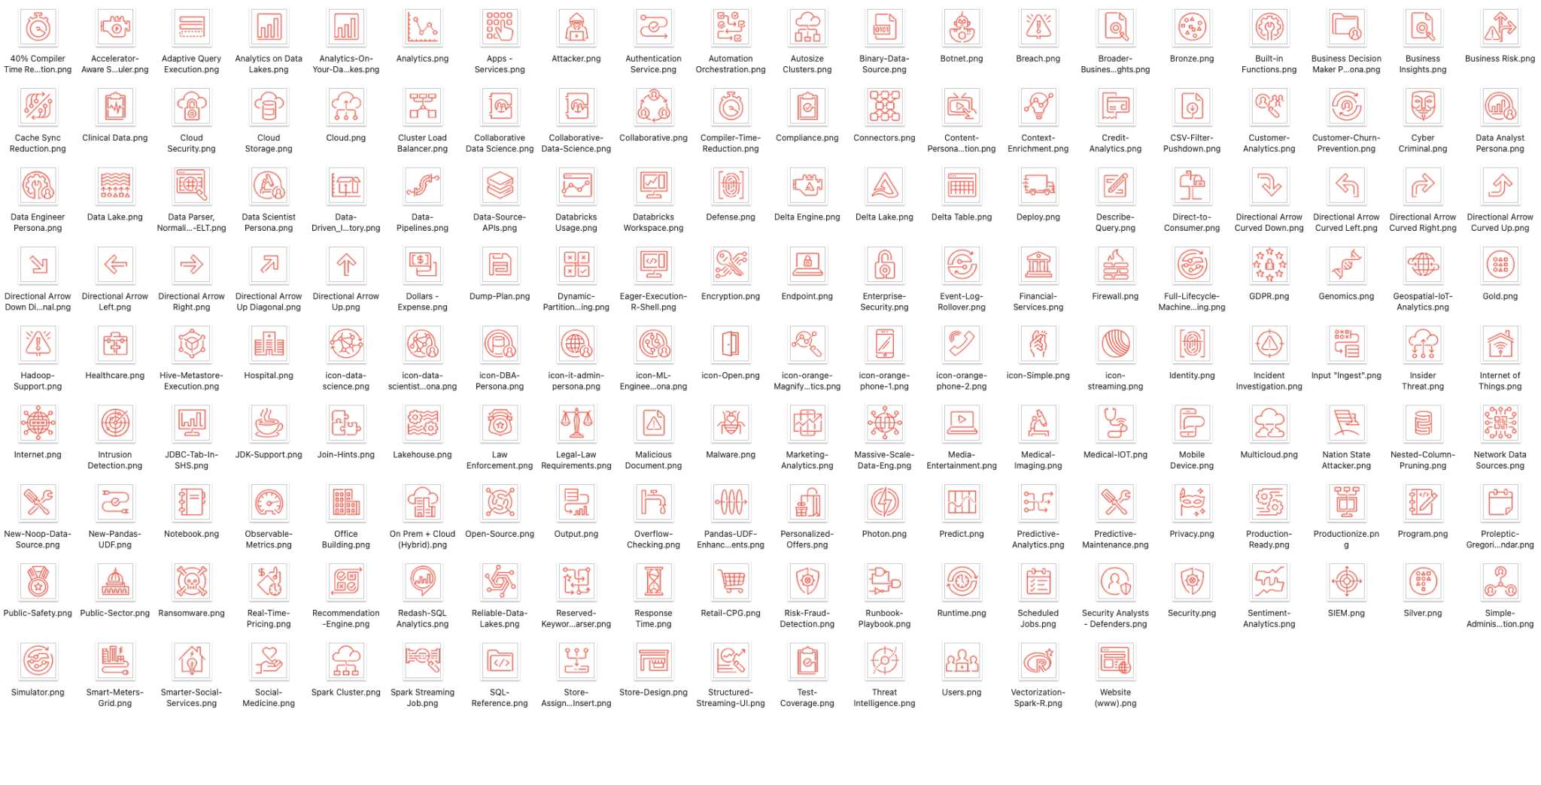
Databricks Icons - Overview in orange

Slide 26
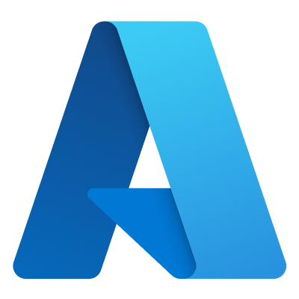




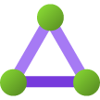

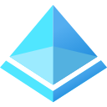
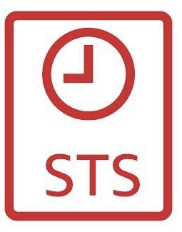










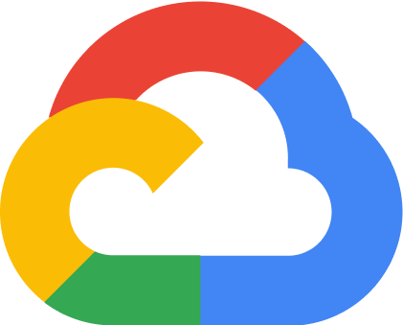

Cloud Service Logos (selected)
Ingest
Storage
Serve
Analysis/Output
Resources
Azure IoT Hub
Azure Event Hub
Azure Data Factory
Azure Data Lake Storage
SQL DB
Cosmos DB
Azure Synapse Analytics
Power BI
Private Link
Firewall
Network Security Group
Express Route
ExpressRoute Gateway
AAD
AWS IoT Core
Amazon Kinesis
Amazon AppFlow
Amazon S3
Amazon RDS
Amazon DynamoDB
Amazon Redshift
Amazon QuickSight
AWS STS
Endpoint
AWS DMS
AWS Glue
Amazon Athena
Gateway
VPN
Gateway
Peering Connection
**
Cloud IoT Core
Pub/Sub
Datastream
Cloud Storage
Cloud SQL
Data store
BigQuery
Looker
Cloud NAT
Cloud NAT
Cloud
Data Fusion
Storage Transfer Service
Cloud BigTable
** To be decommissioned mid of 2023

Slide 27
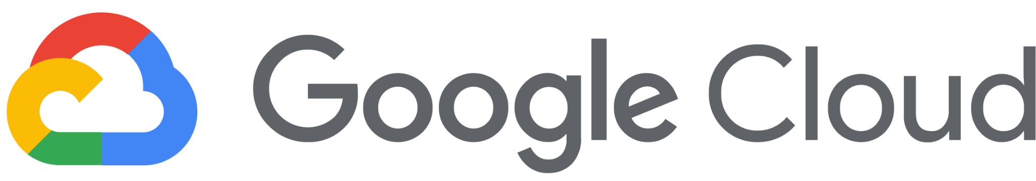


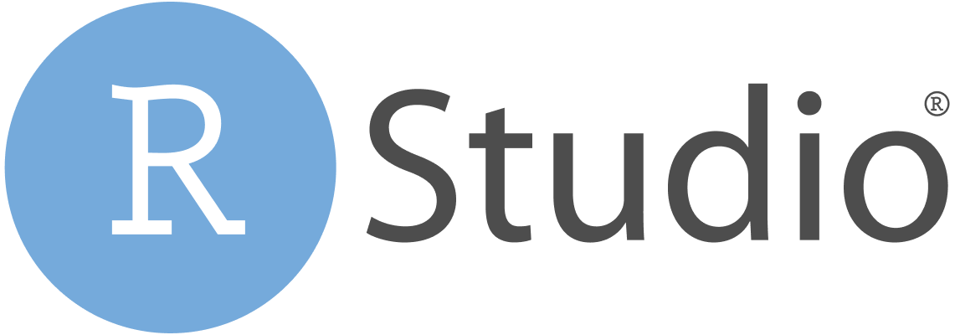


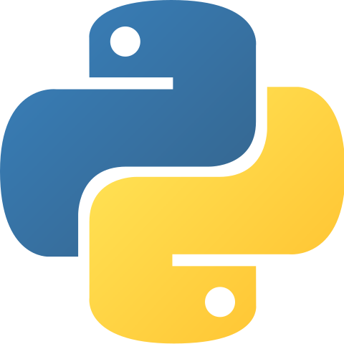
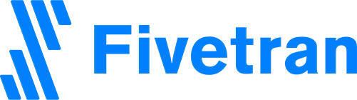

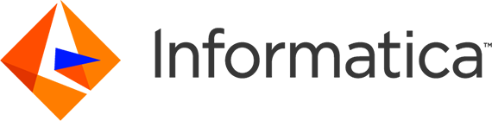



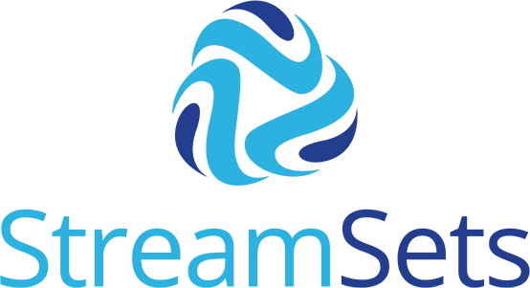
Partner Logos
Python

Slide 28
Some tricks

Slide 29
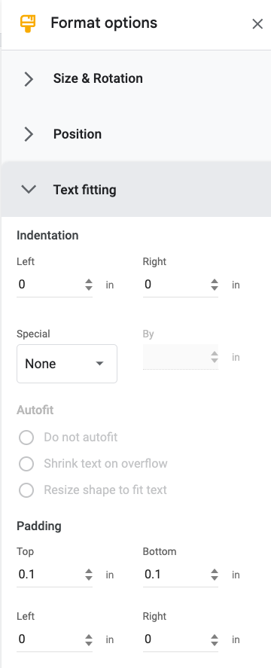
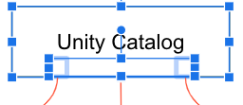
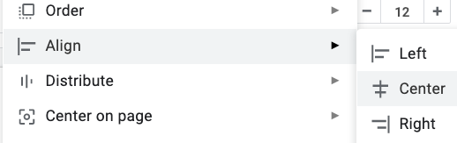
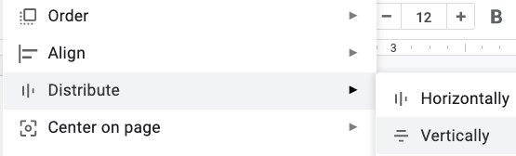
1 Add texts to boxes instead of having (larger) text elements placed upon a box
3 Use small transparent boxes and group them with the parent shape when you need more connectors to glue shapes together before dragging them, around
Unity Catalog
Unity Catalog
Unity Catalog
Unity Catalog
1
2
3
2 Change padding if text is slightly too large
4 Use Menus “Arrange → Align” and “Arrange → Distribute” to place shapes
Unity Catalog
1
1
1
2
2
2
Unity Catalog
3
3
3

